Slide 1
Liver function test
Dr Reshmy K.R
Professor
Dept.of Physiology
SKHMC

Slide 2
Functions of Liver
1.Synthetic Function
Liver participates in formation of blood (particularly in embryo)
  Synthesis of plasma proteins (albumin and prothrombin), hormones e.g angiotensinogen, insulin-like growth factor and triiodothyronine ,cholesterol, triglycerides and lipoproteins
Destruction of erythrocytes (Bilirubin)
2.Detoxification and excretion
Kupffer cells of liver perform phagocytosis to eliminate foreign compounds.
-ammonia is detoxified to urea and metabolism of xenobiotics (detoxification).
Clearance of hormones such as insulin, parathyroid hormone, oestrogen, cortisol,
  bilirubin, cholesterol, drug metabolites

Slide 3
3.Storage Function
  Glycogen,Vitamins A, D, E, K and B₁₂
4.Production of bile salts
  Helps in digestion
Serum enzymes
Acting as markers of liver damage

Slide 4
Liver function tests(LFT)
Helps to detect the abnormalities and extent of liver damage.
Noninvasive methods for screening of liver dysfunction
Assess severity and allow prediction of outcome
Treatment follow up

Slide 5
LFT comprises of:
Total protein
  Albumin and globulin
  (Prothrombin Time)
  Transaminases – AST & ALT
  Alkaline PO₄ase
  Bilirubin, usually fractionated
  Gamma Glutamyl Transpeptidase (GGT)

Slide 6
LFT classified as:
Tests to detect hepatic injury:
  Mild or severe; acute or chronic
  Nature of liver injury (hepatocellular or cholestasis)
Tests to assess hepatic function
Group I: Markers of liver dysfunction
  Serum bilirubin: total and conjugated
  Urine: bile salts and urobilinogen
  Total protein, serum albumin and albumin/globulin ratio
  Prothrombin Time

Slide 7
Group II: Markers of hepatocellular injury
  Alanine aminotransferase (ALT)
  Aspartate aminotransferase (AST)
Group III: Markers of cholestasis
  Alkaline phosphatase (ALP)
  g-glutamyltransferase (GGT)

Slide 8
Common serum liver chemistry tests

Slide 9
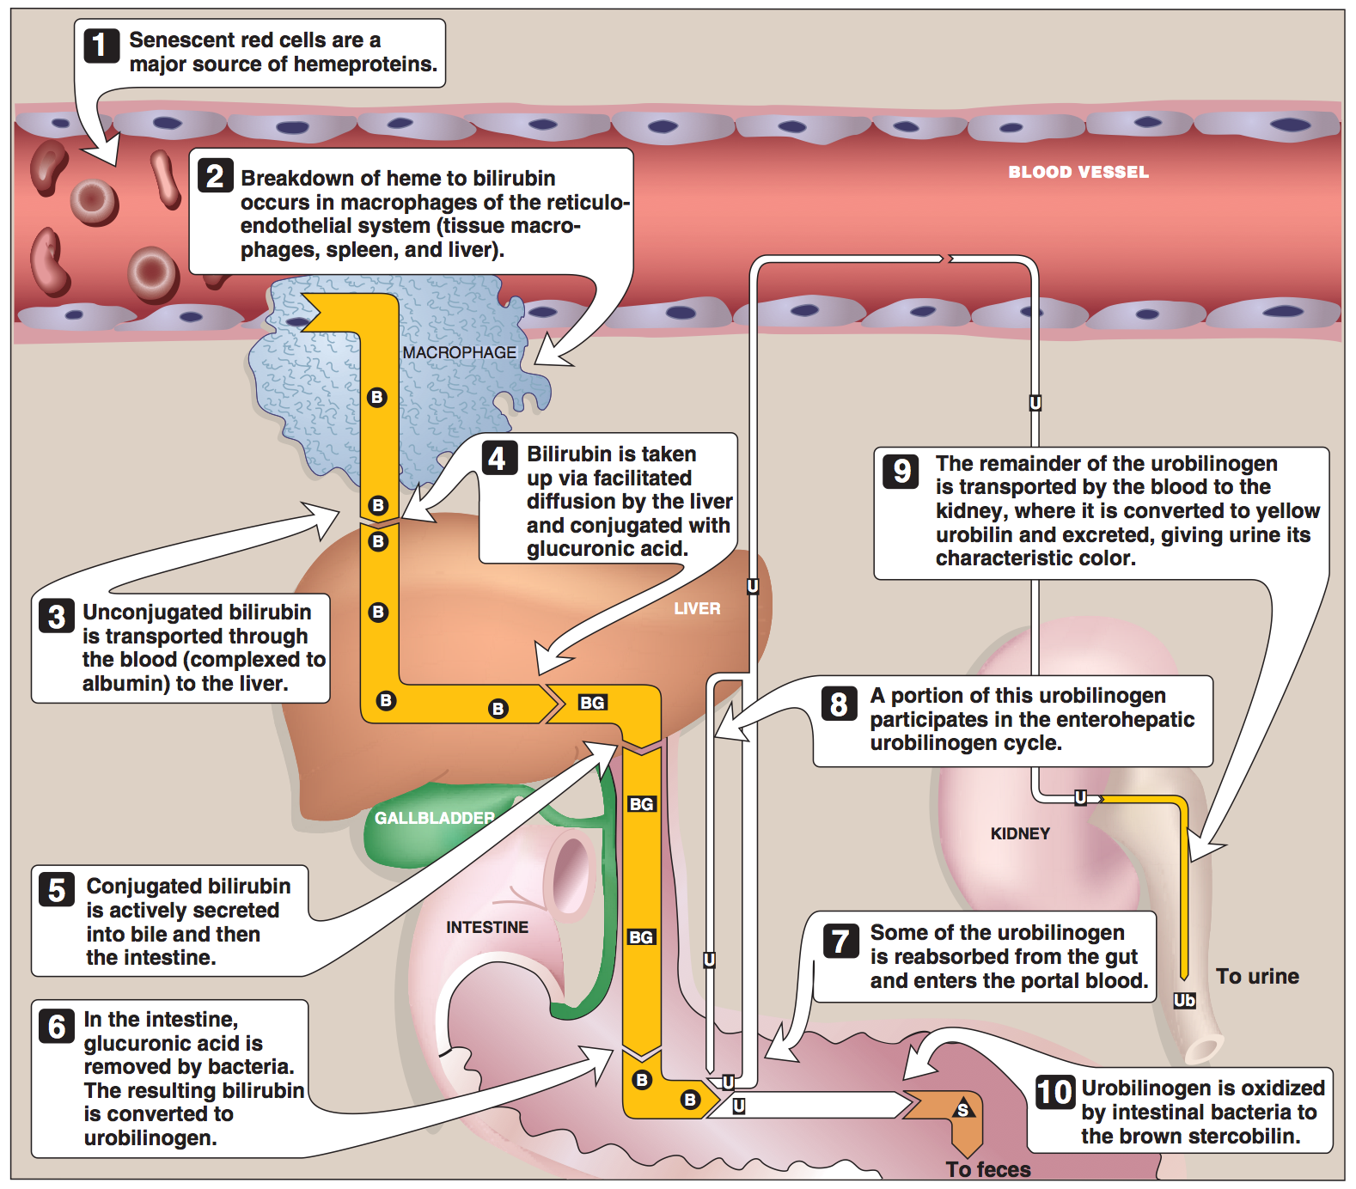
Bilirubin
Normal - 0.2 – 0.8 mg/dL
Unconjugated (indirect): 0.2 – 0.7 mg/dL
Conjugated (direct) : 0.1 – 0.4 mg/dL
Latent jaundice:Above 1 mg/dL
Jaundice: Above 2 mg/dL

Slide 10
Types of Jaundice
Jaundice -Types | Causes
Pre-hepatic or hemolytic | Abnormal red cells; antibodies; drugs and toxins; thalessemia Hemoglobinopathies, Gilbert’s, Crigler-Najjar syndrome
Hepatic or Hepatocellular | Viral hepatitis, toxic hepatitis, intrahepatic cholestasis
Post-hepatic | Extrahepatic cholestasis; gallstones; tumors of the bile duct, carcinoma of pancreas

Slide 11
Urobilirubin
Most UBG is metabolized in the large intestine but a fraction is excreted in urine (less than 4 mg/day)
Normally bile salts are NOT present in urine
Obstruction in the biliary passages causes:
  Leakage of bile salts into circulation
  Excretion in urine

Slide 12
Serum Albumin
The most abundant protein synthesized by the liver
Normal serum levels: 3.5 – 5 g/dL
Synthesis depends on the extent of functioning liver cell mass
Longer half-life: 20 days
Its levels decrease in all chronic liver diseases

Slide 13
Serum Globulin
Normal serum levels: 2.5 – 3.5g/dL
alpha and beta globulins mainly synthesized by the liver
They constitute immunoglobulins (antibodies)
High serum g-globulins are observed in chronic hepatitis and cirrhosis:
  IgG in autoimmune hepatitis
  IgA in alcoholic liver disease

Slide 14
Albumin/Globulin ratio
Normal A/G ratio: 1.2/1 – 1.5/1
Globulin levels increase in hypoalbuminemia as a compensation

Slide 15
Prothrombin time (PT)
Prothrombin: synthesized by the liver, a marker of liver function
Half-life: 6 hrs. (indicates the present function of the liver)
PT is prolonged only when liver loses more than 80% of its reserve capacity
Vitamin K deficiency also causes prolonged PT
Intake of vitamin K does not affect PT in liver disease

Slide 16
Aspartate Amino transferase (AST)
Normal range: 8 – 20 U/L
A marker of hepatocellular damage
High serum levels are observed in:
  Chronic hepatitis, cirrhosis and liver cancer

Slide 17
Alanine AminoTransferase (ALT)
More liver-specific than AST
Normal range (U/L):
  Male: 13-35
  Female: 10-30
High serum levels in acute hepatitis (300-1000U/L)
Moderate elevation in alcoholic hepatitis (100-300U/L)
Minor elevation in cirrhosis, hepatitis C and non-alcoholic steatohepatitis (NASH) (50-100U/L)

Slide 18
ALT
Appears in plasma many days before clinical signs appear
A normal value does not always indicate absence of liver damage
Obese but otherwise normal individuals may have elevated ALT levels

Slide 19
AlkalinePhosphatase (ALP)
A non-specific marker of liver disease
Produced by bone osteoblasts (for bone calcification)
Present on hepatocyte membrane
Normal range: 40 – 125 U/L
Modearte elevation observed in:
  Infective hepatitis, alcoholic hepatitis and hepatocellular carcinoma
High levels are observed in:
  Extrahepatic obstruction (obstructive jaundice) and intrahepatic cholestasis
Very high levels are observed in:
  Bone diseases

Slide 20
γ-glutamyltransferase (GGT)
Used for glutathione synthesis
Normal range: 10 – 30U/L
Moderate elevation observed in:
  Infective hepatitis and prostate cancers
GGT is increased in alcoholics despite normal liver function tests
  Highly sensitive to detecting alcohol abuse

Slide 21
Thank You
References
https://medlineplus.gov/lab-tests/liver-function-tests/

